Slide 1

Beginning Xbox 360 Development with the XNA Framework
Chris Gardner
Senior Software Engineer
T & W Operations, Inc.

Slide 2
Road Map
Necessary Tools and Resources
XNA Game Studio
MSDN App Hub
Game Fundamentals
General Structure
Screen Layout
Demo Time

Slide 3

Necessary Tools Necessary Resources
Everything you need to get started

Slide 4
XNA Game Studio 4
Available Either Stand-alone or bundled with Windows Phone Developer Tools
Integrates into Visual Studio 2010
Supported Development
Windows Phone 7, 7.5 & 7.8
Xbox 360 Indie Games
Windows Games
HiDef (Advanced Graphics for 360 and Windows)
Reach (Cross-Compatibility with All Devices)

Slide 5
XNA Game Studio 4
Installing on Windows 8
Install Visual Studio 2010
Install Games for Windows LIVE for Windows 8
http://www.xbox.com/en-US/LIVE/PC/DownloadClient
Install Game Studio 4

Slide 6
Previous Editions
Game Studio 3
Visual Studio 2008
Zune Games Support (Removed in GS4)
Game Studio 2
Visual Studio 2005
Game Studio Express 1 and 1.1
Visual C# Express

Slide 7
Features
Available
Avatars
Xbox Live (-ish)
Not Available
Achievements
Network Access
Unknown
Kinect

Slide 8
App Hub
http://xbox.create.msdn.com
Software Downloads
Lessons and How-Tos
Sample Code

Slide 9
App Hub Membership
$99 USD per year
Students can receive free year, but cannot publish
Publish 10 Xbox 360 Indie Games (500MB)
Copy Code to Xbox 360
Requires Xbox 360 Creators Club Transfer App
Must be signed into Xbox Live to work.
Peer Code and Content Review

Slide 10
Console Downloads
XNA Creators Club
XNA Game Studio Connect
Listed in Marketplace as Game Add-on
XNA Game Studio Device Center
Add New Device
Name Device
Enter Key from Device

Slide 11

Game Design Fundamentals
Everything you need to know before getting started

Slide 12
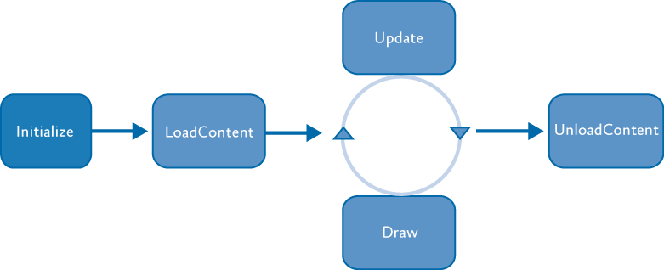
General Architecture
Game Class
Update and Draw can run simultaneously in separate threads (Manual tweaks)

Slide 13
Update
GamePad
Call GamePad.GetState( PlayerIndex.One )
Buttons return ButtonState enum
Pressed
Released
Analog Controls return float
ThumbSticks.[Left|Right] return Vector2 ranging from -1.0 to 1.0
Triggers.[Left|Right] return float ranging from 0 to 1.0
Keyboard
Call Keyboad.GetState and treat like Buttons

Slide 14

Update
Y: 1.0
X: 1.0

Slide 15
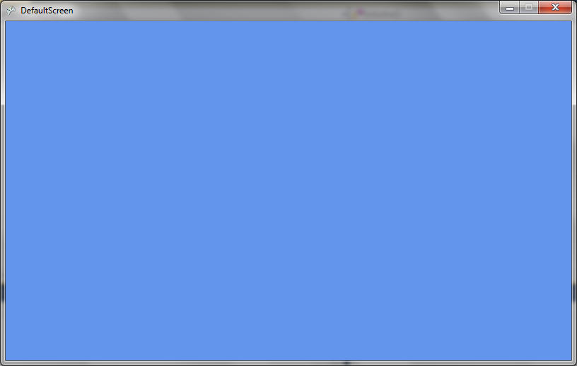
Screen Layout
X
Y
(0, 0)
(GraphicsDevice.Viewport.Width,
GraphicsDevice.Viewport.Height)

Slide 16

Demo Time
Wish me luck…

Slide 17
Questions?
Thank You
Chris Gardner
cgardner@tnwops.com
http://www.tnwops.com
@freestylecoder
+Chris Gardner
http://blog.freestylecoding.com

